Slide 1

Designing for Agility™
ODC Webinar – October 16, 2019
Presented by:
E. Craig McGee, Ph.D.
Solutions

Slide 2
Objectives
Provide an understanding of the basic concepts and design models for designing agile organizations
Provide a step-by-step process for a systems approach to designing agile organizations
Demonstrate applications of design concepts
Provide specific tools useful in designing organizations

Slide 3
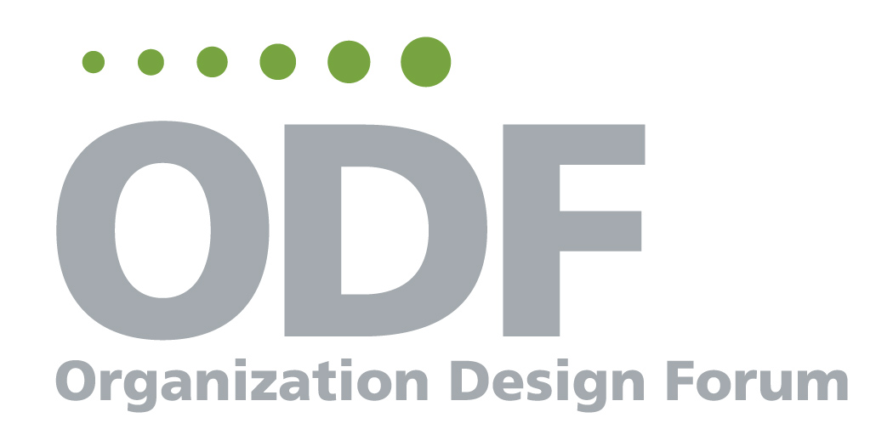


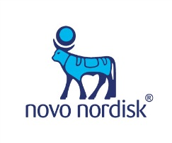




Client Engagements

Slide 4
What is Organizational Agility?
Agility is the ability of an (individual, team or) organization to dynamically sense and respond to changes in the environment with actions that are focused, fast and flexible.
Source: Horney, Pasmore and O’Shea, “Leadership Agility: A Business Imperative for a VUCA World,” People & Strategy, Volume 33-4, 2010.
Notes:
According to Wiliams, Worley and Lawlor, “agility is not just the ability to change. It is a cultivated capability…” (Strategy & Business, The Agility Factor, 4.15.13). They describe it as intentional, for the purposes of achieving competitive advantage.
Key capabilities:
Anticipate and initiate change to sustain high performance when changing circumstances require it
Recognize and respond to strategic challenges
Necessary for thriving in a VUCA world:
Volatile
Uncertain
Complex
Ambiguous

Slide 5
Organizations Require Both Optimization And Adaptive Capabilities
Discontinuous Innovation
Incremental & Architectural Innovation
Discontinuous Innovation
Dominant Design (Industry Standard)
Product Innovation

Mature

End of Life
Number of Innovations

Established
Process Innovation

Emerging

Seed
Source: Sapience, 2012
Notes:
Explain product innovation, process innovation, etc.

Slide 6
Organizations Require Both Optimization And Adaptive Capabilities
Adaptive Approaches
Rapid proto-typing
Network design
Incubators
Skunkworks
Decision Accelerator
Design thinking
Optimization Approaches
Lean/Six Sigma
Kaizen
Process mapping/improvement
Cost efficiency
Plan, Do, Check, Act

Slide 7
The Ambidextrous Solution
Create two organizational architectures inside the same firm
Ensure that they have different:
  Budgets & resources
  Incentive systems
  Reporting relationships
  Cultures
Let one handle the "mature" business, the other the "new"

Slide 8

Agile Organization Design Process Model
Contract
Understand
Business Context
Iterate
Develop
Design
Concept
Implement
Develop
Detailed
Design
Align
Design Elements
Notes:
NOTE: To get a clean copy, must print this page in color. Otherwise some boxes will appear on the circle that should not appear.
Why these steps?
Intuitive process for ensuring the best design
more likely to “get it right the first time” using this approach
tested by organization design experts from many industries
Implementation actually starts with contracting and carries on through the steps
Implementation factors are addressed in the contracting phase - who will lead the “project” in its various stages? What design approach will be used?
Design approaches for steps 3 & 4 help or hinder implementation, depending on the culture of the business
One should be anticipating implementation issues through all steps, and using the process to forestall implementation problems (e.g. early, ongoing communication; positioning project leaders for more permanent roles, using design approaches that will facilitate, accelerate implementation)

Slide 9
Designing for Agility™
Step 2: Understand the Business Context
Contract
Understand
Business Context
Iterate
Develop
Design Concept
Implement
Develop
Detailed Design
Align
Design Elements

Slide 10
Basic Elements of Business Context
Identify vision, mission internal and external factors stakeholder perspectives business strategy | Assess strategic capability current position of the organization in its market gaps between desired and actual performance opportunities for new markets, products , etc.
Understand the organization’s culture products and services key business processes people capability | Develop design criteria what the organization must be able to do to achieve the desired strategy basis for key design decisions
Reproduction not allowed without permission
Notes:
We have all done organization diagnostic work in our practices. Depending on the purpose of the project, we focus on different aspects of organization. And there are a number of diagnostic tools (Schein, Denison, Nadler, Daryl Conner). I prefer to do most of this with a combination of targeted in-depth interviews, focus groups and data analysis.
When conducting a redesign we look at the organizational system how it’s positioned to meet its strategic goals:
Identifying the basic focus of the business, current measures, its customers, and its strategic direction
On a high level, getting a handle on current culture and how it is operating now, how the work is done, the effectiveness of product and service development and delivery, core competencies of the business and people competencies
Based on that information, assessing the strategic capability of the organization in its markets, and the extent to which it has the capability to achieve its strategy within the given time frame
Developing design criteria for an organization that will move the business toward strategic goals.
So, in this type of diagnostic, we would use as much information as already exists, and seek out enough information to help us move to obtaining design criteria. We need to do that quickly and efficiently; one way to shorten cycle time for this piece is to do some of this in a large group.

Slide 11

Statement of Strategic Intent (SSI)
SSI is about
Focus of Action
Not vision or mission
Role of an SSI in organization design:
Indicates how the organization will achieve competitive advantage in the long term
Makes clear tradeoffs / choices (what the organization is and is not willing to do)
Emphasizes products and services
Provides the foundation from which concrete goals and actions can be developed by all stakeholders
Stated in a way that can be easily and clearly understood by all stakeholders.
Reproduction not allowed without permission
Notes:
This slide highlights something we see as the foundation to effective organization design. Having a clear strategic direction provides the “true north” for your design work. As we work through our business analysis step, ideally that work has been done already by the client. But often it hasn’t, and we find from our data-gathering that there may not be clear consensus among senior leaders on the strategic direction of their organization.
Rather than focus on building an in-depth strategic plan, we work with organizational leaders (people at the top) to articulate what we call a Statement of Strategic Intent, for the purposes of providing a foundation for design work. A Statement of Strategic Intent is not a mission statement or a vision, it’s a focus for action in the context of Vision and mission. It’s a stake in the ground that serves as true north for the organization.
We look to create a couple of sentences that describe (what you see above)
We ask participants in our workshop to create an SSI either for a case we provide or for their own organizations, so that they can lead others through it.
Let’s look at an example.

Slide 12
Statement of Strategic Intent: Edward Jones
Edward Jones’s
Strategy Statement
To grow by 17,000 financial advisors by 2012 by offering trusted and convenient face-to-face financial advice to conservative investors who delegate their financial decisions, through a national network of one-financial-advisor offices.
“conservative”
Our investment philosophy is long-term buy and hold. We do not sell penny stocks, commodities, or other high-risk instruments. As a result, we do not serve day traders and see no need to offer online trading.
We charge commissions on trades because this is the cheapest way to buy stocks (compared with a wrap fee, which charges annually as a percentage of assets) when the average length of time the investor holds the stock or mutual fund is over 10 years.
“individual”
We do not advise institutions or companies
We do not segment according to wealth, age, or other demographics. The company will serve all customers that fit its conservative investment philosophy. Brokers will call on any and every potential customer. Stories abound within Jones of millionaires who live in trailer – people all the other brokerages would never think of approaching.
“investors”
Our basic service is investment. We do not seek to offer services such as checking accounts for their own sake, but only as part of the management of the client’s assets.
“who delegate their financial decisions”
We do not target self-directed do-it-yourselfers, who are comfortable making heir own investment decisions. We are also unlikely to serve validators, who are merely looking for reassurance that their decisions are correct.
Source: HBR, April 2008
Notes:
We had been talking about the SSI for a few years when an article came out in the April, 2008 HBR – “Do You Know What Your Strategy Is?”, talking about Edward Jones’ financial advisory firm. It’s such a great example, we’re using it here.
In their statement of strategic intent, Edward Jones states very clearly how it will differentiate itself in the financial advisor market in the next few years.
While this also has elements of a mission statement, it focuses more on the How rather than the What/To what end of the business.
It provides a clear direction for design by telling us what they will do, as well as what they will not do!
So, a clearly stated SSI provides basis for key decisions regarding organizational structure – network of single person offices in easily accessible locations;
Clear product definition- buy and hold investments, no on-line trading
As well as information about the target market – investors who delegate, but no demographic boundaries.
Begins to define needs for information management - and staffing competencies.
There’s a lot more to strategy, but something like this provides enough direction to help us get started with design criteria.

Slide 13
Design Criteria
Organizational capabilities are:
  Unique, integrated combinations of skills, processes, and human abilities
  Created by and housed within an organization
  Factors that differentiate the organization and provide competitive advantage
Organizational Capabilities = Design Criteria
12
Reproduction not allowed without permission
Notes:
Toyota – Toyota Production System
Honda – Engine technology
Intel – chip design
Qualcomm – chip design
Apple – OS and design

Slide 14
Design Criteria – A Key Output
Describe core capabilities of the new design, e.g., Capable of doubling product offerings in next 3 years Broad geographic scope and product variety Enable instant deployment of information to all decision-makers Hold a collaborative and entrepreneurial culture
Define resource parameters, e.g., Maintain small corporate center No more than 1 facility per country
Outline critical characteristics, e.g., Single point of contact for customers Ability to cross-sell different products
Reproduction not allowed without permission
Notes:
Your Statement of Strategic Intent provides a good part of the direction for creating design criteria. Other information, like core competencies, culture assessments, competitive analyses, are also part of the equation.
Design criteria tell us: What does the new organization need to look like, and be able to do? What is the size and scope of the organization? What kinds of resources will be required? What are some key culture characteristics?
Example on next page

Slide 15

Sample Design Criteria: Global HR Redesign
Deliver full spectrum of HR support and service at lower cost than today
Deliver support and services with fewer people
Deliver support and services with greater speed, flexibility, and quality (in eyes of customer)
Simple to execute on the ground; drives accountability to lowest appropriate level
Creates and maintains blended portfolio of services; “state of art” with “state of shelf”
Provides controls to govern cost and scope creep
Ensures retention of best talent
Reproduction not allowed without permission
Notes:
These criteria, for a redesign of HR at a global medical device business, provide some very specific direction for potential structure, process and systems and staffing.
For example, some implications of these are:
Smaller staff with the capability to provide both strategic and operational HR services
Straightforward work flow
Relatively flat structure (decision making at the lowest appropriate level)
Incorporates regulatory expertise/function
You probably have some different approaches to developing design criteria in your work.

Slide 16
SSI and Design Criteria – Technology Company
Statement of strategic intent (condensed):
Continue to be a market leader in middleware products by reducing time to market for new and innovative set of products targeted at large database users
Design criteria
In order to execute our strategy, we must be able to:
  Develop innovative products quickly (both product extensions and disruptive technologies)
  Develop a broad suite of products that integrate effectively with different technologies
  Understand the requirements of our customers that will give them competitive advantage
  Create stronger partnerships with key stakeholders (internal and external)
  Move products to market quickly (from concept to delivery)
  Support launched products fully with in-depth technical knowledge of the products
  Develop the breath and depth of expertise of our employees
….better than our competitors

Slide 17
Creating Design Criteria
“In order to achieve our priorities, our organization needs to be able to…
  Do X
  Y
  Z
  …better than the competition”
16
Reproduction not allowed without permission

Slide 18
Understanding Business Context - Summary
Steps | Tools / Method | Deliverables
Review organization mission and strategy Assess current vs. desired business performance Understand organizational culture – values, norms, behaviors Assess strategic capability of organization (strengths/weaknesses) Identify design criteria | Mission, vision, values review Statement of Strategic Intent conversation Data–gathering / review of business performance against financial, production, customer expectations Culture diagnostic interview / survey Organization Diagnostic Tool (Structure, Process, Mgmt Systems, Culture vs. Strategy) Stakeholder Mapping Design criteria development process | Statement of Strategic Intent Strategic strengths and gap analysis Organization culture assessment Roadmap of Key Issues/ Org Design Action Plan Stakeholder Strategy Criteria for Redesign
Reproduction not allowed without permission
17

Slide 19
Designing for Agility™
Step 4: Creating a Detailed Design
Contract
Understand
Business Context
Iterate
Develop
Design Concept
Implement
Develop
Detailed Design
Align
Design Elements
Reproduction not allowed without permission

Slide 20
Organizations as Systems
Structure
Roles and
Responsibilities
Structure
Values
Information
Flows
Leadership
Culture
Process
Staffing
Process
Technology
Rewards
Systems
Source: Solutions
Performance
Management
Training
Goals and Metrics
Reproduction not allowed without permission

Slide 21
Detailed Design Deliverables
Work Processes
Structural Boundaries
Roles/Responsibilities
Work Group Deliverables
Information Flows
Integration Mechanisms
Reproduction not allowed without permission

Slide 22
Detailed Design Process
Define boundaries
Re-contract
Map core business process(es);
Identify disconnects
Redesign processes
Develop new structure
Define information flows
Define individual jobs/roles and decision making authority
Define interdependencies and “handoffs”
Reproduction not allowed without permission
Notes:
Macro-design is a “theory” about the best design; use micro design to validate the theory
Our experience is that the design concept often is pre-determined at a high level

Slide 23
Understanding Core Business Process…
…is essential to defining boundaries
Based on the mission, define what the basic transformation process is
  process starts with… process ends with…
Define inputs and outputs throughout the process
Describe activities that occur throughout the process
Reproduction not allowed without permission

Slide 24
Identify Disconnects in the Process
For each step of the process, identify what typically goes wrong
Examples:
  late order
  “bug” in software
  excessive material usage
  out-of-spec product
  unable to respond to new customer request
  Unable to respond to market changes
  Late to market with new products
Reproduction not allowed without permission
Notes:
Refer to Six Sigma and Lean

Slide 25
Clarify the Critical Few Disconnects
Distill the large number of “variances” to the critical few
Criteria
Produces large financial impact
Causes other variances
Is a root cause
Has significant impact on health, safety, or environment
Impacts agility
Reproduction not allowed without permission

Slide 26
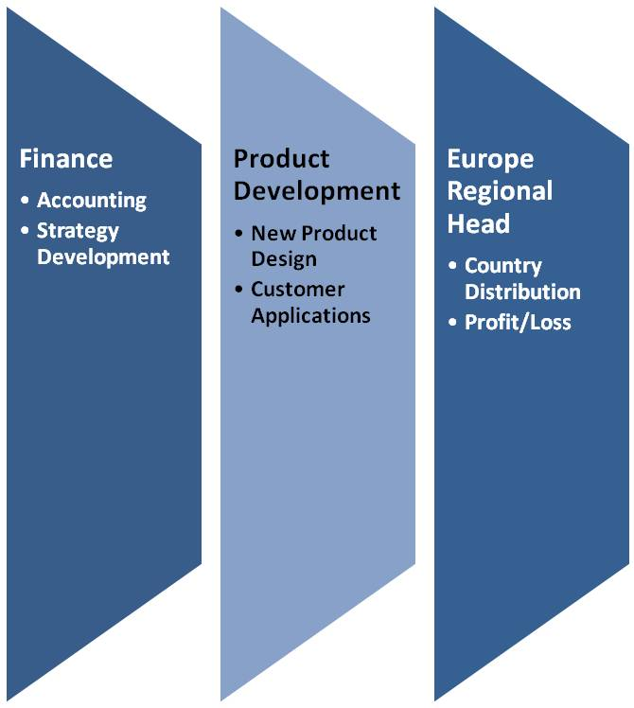
Detailed Design – Roles
Define key tasks, responsibilities and decisions for different roles
Define levels of involvement in different decisions
Define governance roles and processes
Define “hand-offs”…what information/material needs to be passed and what are the specifications
  Within the work group
  With other work groups and stakeholders
Reproduction not allowed without permission

Slide 27
CAIRO Responsibility Charting
C onsult
zer O
A pprove
CAIRO
R esponsible
I nform
….is critical for clarifying governance responsibilities
Reproduction not allowed without permission

Slide 28
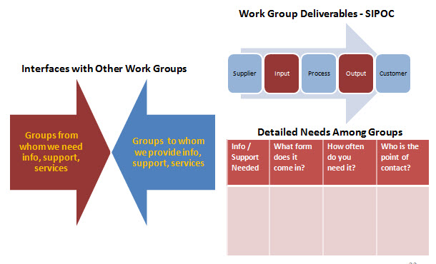
Some Tools for Information/Process Flow
Reproduction not allowed without permission

Slide 29
All Organizations Require Integrative Mechanisms
Organizational Processes
Standards/Procedures
Processes
Measures
Plans/Goals
Norms
Lateral Integrating Roles
Linking Roles
Mirror Organizations
Overlapping Membership
Informal Lateral Processes
Co-location
Networks
Rotation
Interdepartmental Events
Databases/IT Systems
Formal Roles & Structures
Teams
Project/Product Managers
Committees
Centers of Excellence
Reproduction not allowed without permission

Slide 30
Designing for Agility™
Step 5: Aligning the Design Elements
Contract
Understand
Business Context
Iterate
Develop
Design Concept
Implement
Develop
Detailed Design
Align
Design Elements
Reproduction not allowed without permission

Slide 31
Organization Alignment Model
Structure
Roles and
Responsibilities
Structure
Values
Leadership
Information Flows
Culture
Work Process
Staffing
Process
Technology
Rewards
Systems
Source: Solutions
Performance
Management
Goals and Metrics
Training
Reproduction not allowed without permission
Notes:
How can we achieve alignment? This hexagon illustrates the different components, or levers, that can be pulled to achieve that culture/strategy fit.
We use this hexagon model throughout the design process, first as a framework for organizational assessment. Here as a way to focus on specific management systems that impact people’s motivation and behavior. These are highlighted in red wording. It is here that we refocus back on the relationship between your strategy and the organizational culture – norms, and rituals and behavior that make your organization unique.
Example: If your strategy calls for a more customer-centric design targeting emerging markets, you’ll need to focus on generating a global mindset and the people competence to be really creative and flexible in adapting products and methodologies for Asia, Africa, and parts of South America. You will need to assess which of these organizational components play the biggest role in helping you do create a new mindset and capability, how changes in some components will affect the others, and how to orchestrate these changes for greatest effectiveness and efficiency.
This has a diagnostic associated with it, and is a great tool for discussion with your clients, and for teams, and even large groups, to use in self-assessing and design. We use it in our 3-day workshop in greater depth. It’s a good complement to the STAR model, if you use that in your work.

Slide 32
Organization Alignment Case
Goal: Customer
Responsiveness
Structure
Maintained business unit structure
Values
Cost cutting
Series of work sessions with top executives to define culture, values and role of process owners
Roles and Responsibilities
Process roles not well defined
Clarified roles within processes
Dual responsibilities for GMs
Information Systems
SAP Introduction
Management Style
High control
Series of work sessions with top executives to define culture, values and role of process owners
Culture
Process
SAP Best Practices
Staffing
Technology
SAP Introduction
Rewards
General Managers rewarded for margin contribution; Compensation systems revised
Gain sharing plans at sites not aligned with processes
Team Skills
Career path functional or within business unit
  Training
Little/no training to support agility;
Personal development plans focused on functional skills
Goals and Metrics
Conducted skills inventory to identify training requirements. Personal development plans for key roles
Metrics revised
Source: Solutions
Reproduction not allowed without permission
Notes:
In the next series of discussions, the leadership group used this tool to look at what management systems (policies, programs, practices) that needed to be redesigned in order to encourage a culture shift.
Old policy is written in red, and changes involving each policy/system are noted in blue (small print).
Fortunately, this group looked to themselves first.

Slide 33
Organizations Require Both Optimization And Adaptive Capabilities
Adaptive Approaches
Rapid proto-typing
Network design
Incubators
Skunkworks
Decision Accelerator
Design thinking
Optimization Approaches
Lean/Six Sigma
Kaizen
Process mapping/improvement
Cost efficiency
Plan, Do, Check, Act

Slide 34
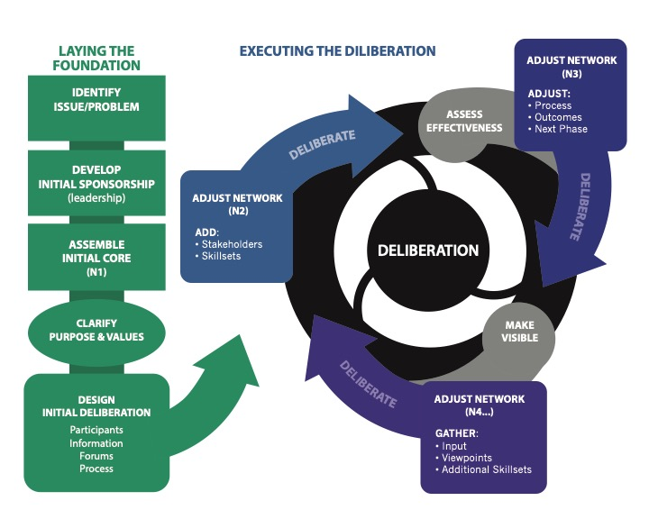
Deliberations Form the Core of Adaptive Structures

